Slide 1
Hughes Airwest DC-9 vs. USMC F-4B

Slide 2
June 6th, 1971
McDonnell Douglas DC-9-31
USMC Douglas F-4B Phantom II
50 killed, 1 survivor
Duarte, California

Slide 3
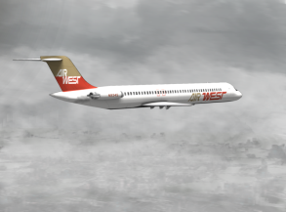
DC-9-31
Twin-engine, single-aisle jet airliner.
Designed for frequent, short flights.
-Artist impression of N9345

Slide 4
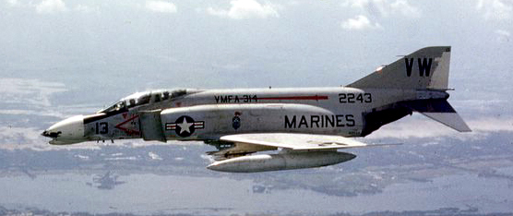
F-4B Phantom II
-U.S. Marine Corps F-4B Phantom II similar to the one involved
Two seat, twin-engine, all-weather, long-range supersonic jet interceptor fighter/ fighter-bomber
Originally developed for U.S. Navy by McDonnell Aircraft, later adopted by the U.S.M.C and U.S.A.F.

Slide 5
DC-9 Flight 709 History
Put into service in 1969
Scheduled route between L.A., CA and Seattle, WA.
5 stopovers
5,542 airframe hours
Pilot: Cpt. Nicolay
Co-Pilot: 1st Officer Bruner

Slide 6
F-4B ‘458’ Flight History
Active since April 15, 1964
Consigned to the U.S. Marine Corps
Two plane cross-country flight
Pilot: Lt. Phillips
RIO: Lt. Schiess

Slide 7
Issues with the 458
Inoperative radio
Inoperative transponder
Oxygen system leak
Degraded radar system

Slide 8
What happened?
Worsening weather conditions
‘458’ elevation: 1,000 ft. → 15,500 ft.
Aileron roll: 360°
Radar failed
2 points of impact
10 Feet

Slide 10
Collision

Slide 11
-Crash site of Flight 706 in the San Gabriel Mountains

Slide 12
-Impact site of ‘458’ on Mount Bliss , approximately 1 mile from the airline wreckage

Slide 13
Survival
Impossible for commercial passengers
Collision
Disintegration
Crash
Fire
Both crewmembers of Phantom could have lived
Design flaw in ejector seat

Slide 14
Probable Cause
Failure to see each other
High closure rate
IFR/ VFR
Failing equipment

Slide 15
Recommendations
Video/audio surveillance in ATC facilities
Air traffic controlled airspace for entire duration of all IFR air traffic
Improved definitive procedures for spotting/tracking of code 7700 aircraft

Slide 16
Additional Recommendations
FAA & DOD cooperate to develop program to mitigate collisions and near-misses between civilian and military aircraft
DOD restrict high-speed, low-altitude aircraft operation in civilian air corridors, consider collision avoidance technologies on military aircraft, and make military pilots aware of FAA’s radar advisory service

Slide 17
References
National Transportation Safety Board. (30 August 1972). Aircraft accident report: Hughes Air West DC-9, N9345 and U.S. Marine Corps F-4B, 151458, near Duarte, California, June 6, 1971, p. 1-50. [PDF] [Last Accessed 08 October 2012].
Federal Aviation Administration. (26 July 2012). Air Traffic Control Section 2. Beacon Systems. [ONLINE] Available at: http://www.faa.gov/. [Last Accessed 08 October 2012].
Aviation Safety Network. (24 October 2011). ASN Aircraft accident McDonnell Douglas DC-9-31 N9345 Duarte, CA. [ONLINE] Available at: aviation-safety.net/. [Last Accessed 08 October 2012].
SmugMug, Inc. (2012). June 6, 1971, Hughes Air West / USMC, McDonnell Douglas DC-9 (N9345) / McDonnell Douglas F-4B (151458) Mid-Air Collision near Duarte, CA- LOSTFLIGHTS Historical Aviation Studies and Research. [ONLINE] Available at: http://lostflights.smugmug.com/. [Last Accessed 08 October 2012].
The Portsmouth Times, AP. (19 June 1971). Military Craft Due to Fly by Civilian Rules, p. 7. [PDF] [Last Accessed 08 October 2012].
The Deseret News. (17 June 1971). 10 More Feet-50 Lives, p. 1. [PDF] [Last Accessed 08 October 2012].

